Slide 1
Movie Recommender System: Unsupervised Machine Learning
Team 10

Slide 2






Unsupervised Learning Predict
African Roots
Mulalo Malange
Thandiwe Khalaki
Data Scientist
Data Scientist
John Siphiwe Seelamo
Rebecca Kekana
Njabulo Nyembe
Data Scientist
Data Scientist
Data Scientist

Slide 3
Presentation Outline
Case Study Background and Problem Statement
Exploratory Data Analysis (EDA)
Model Performance and Deployment
1
3
5
2
Building of Models
4
6
Data Processing and Engineering
Conclusion

Slide 4
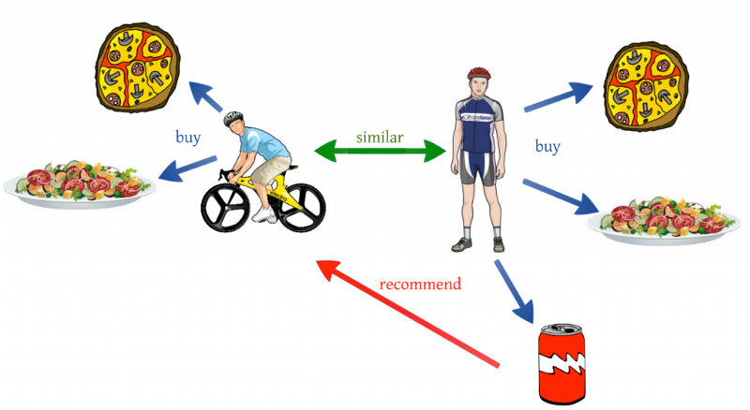
Introduction – Recommender Systems

Slide 5
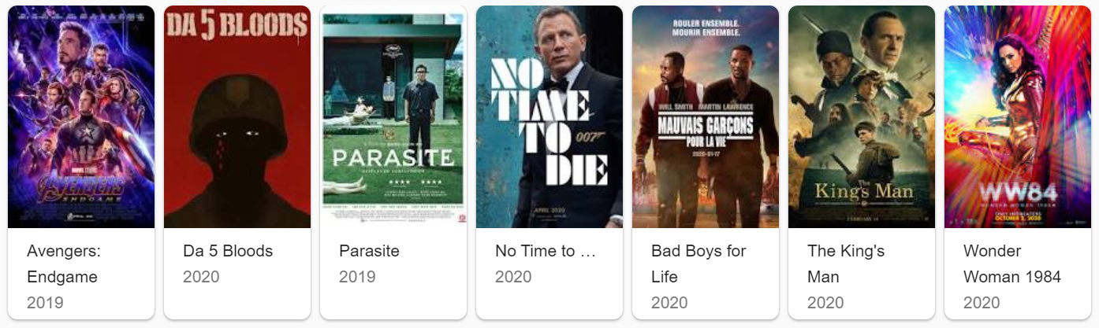
Problem Statement
Build a recommendation algorithm based on content or collaborative filtering, capable of accurately predicting how a user will rate a movie they have not yet viewed based on their historical preferences.

Slide 6

The Datasets
 | Data Set | Shape
0 | Train | (10000038, 4)
1 | Test | (5000019, 2)
2 | Movies | (62423, 3)
3 | IMDB | (27278, 6)
4 | Links | (62423, 3)
5 | Tags | (1093360, 4)
6 | Genome scores | (15584448, 3)
7 | Genome tags | (1128, 2)

Slide 7
Exploratory Data Analysis
We took five approaches in exploring our data, namely:
Basic Data Analysis
Genre Analysis Approach
Year Analysis Approach
Rating Analysis Approach
User Analysis Approach
Directors, Actors and Plots Approach
Budget Analysis Approach

Slide 8
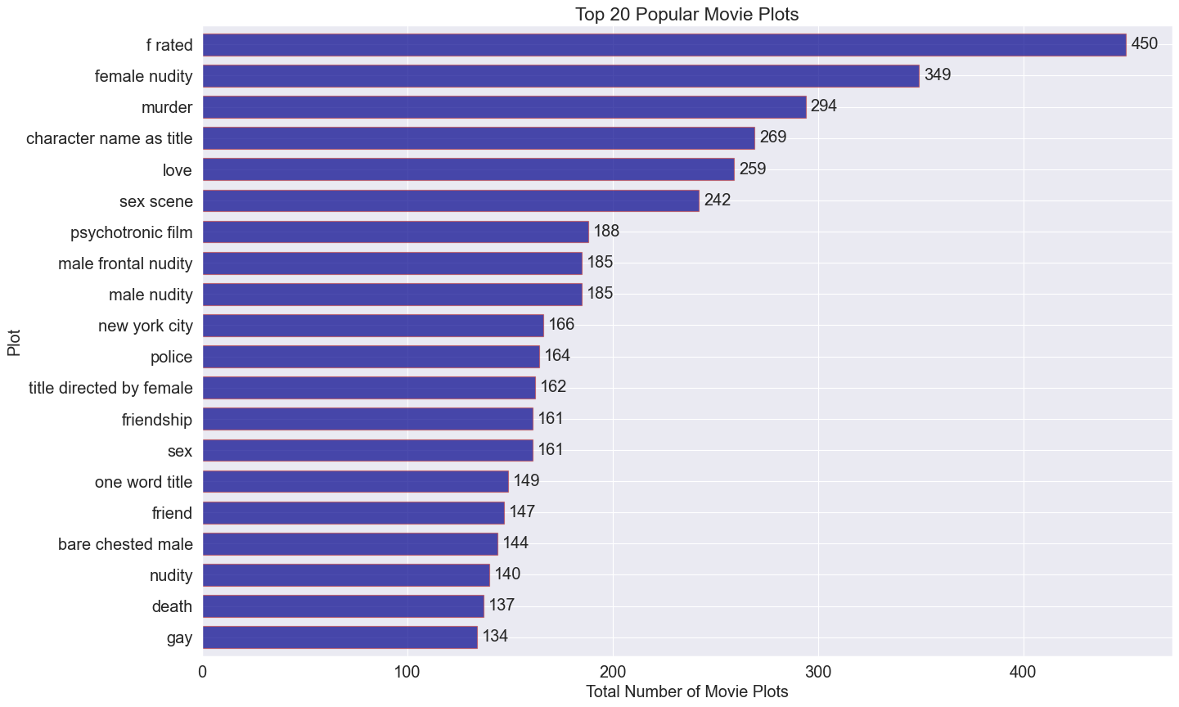
Exploratory Data Analysis

Slide 9
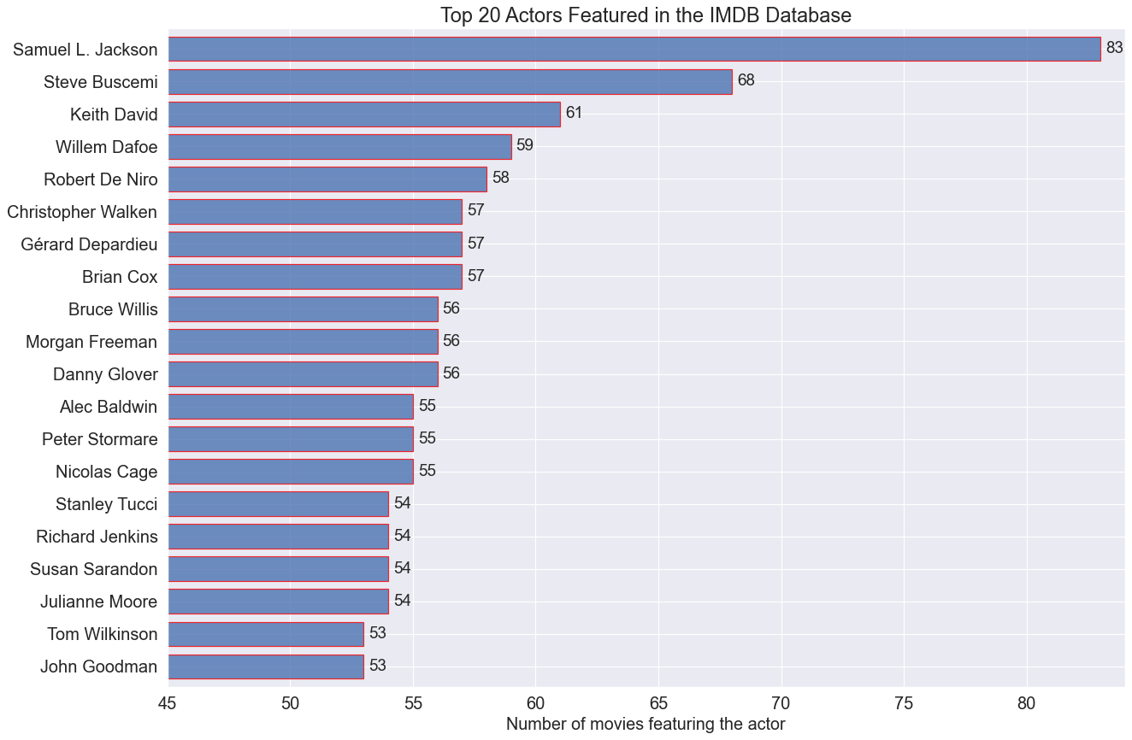
Exploratory Data Analysis

Slide 10
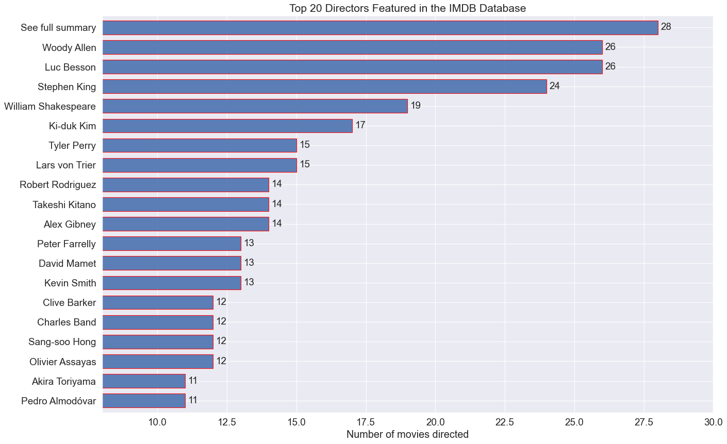
Exploratory Data Analysis

Slide 11
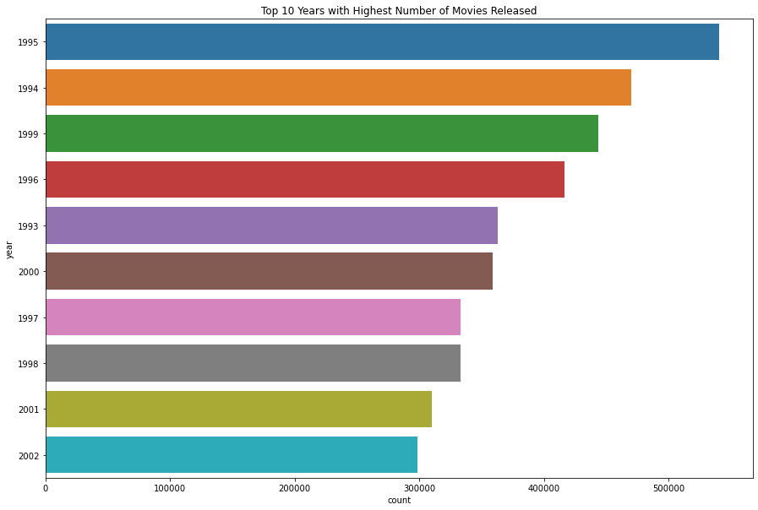
Exploratory Data Analysis

Slide 12
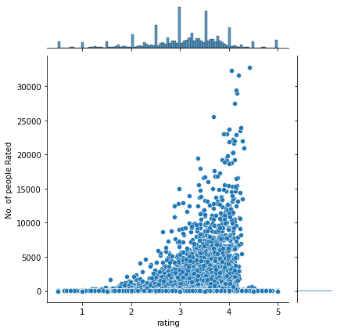
Exploratory Data Analysis
Movie Rating Distribution

Slide 13
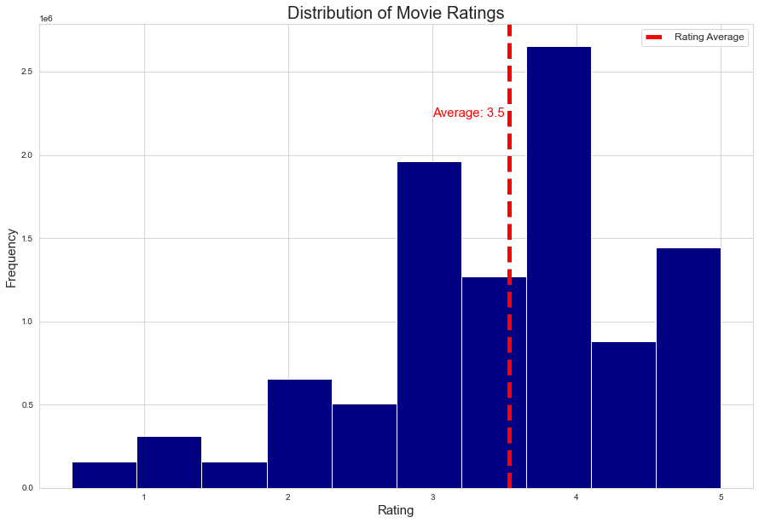
Exploratory Data Analysis

Slide 14
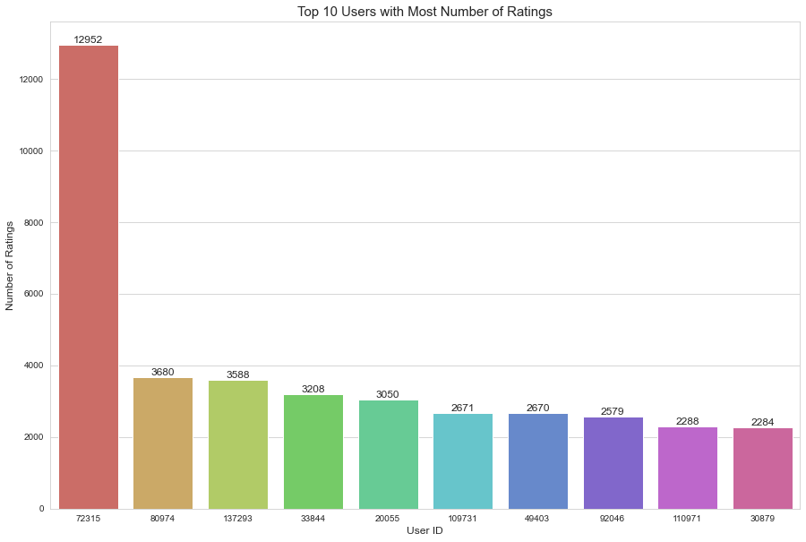
Exploratory Data Analysis

Slide 15
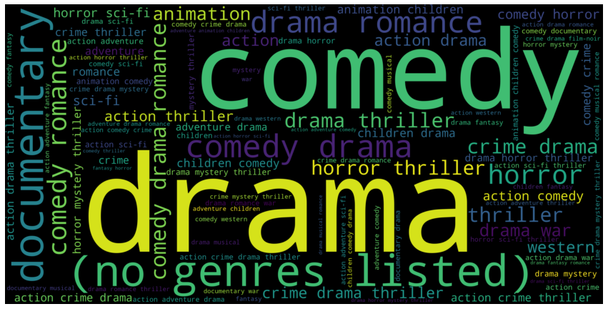
Exploratory Data Analysis
Popular Movie Genres

Slide 16
Building of Models
SVD
SVD++
SVD (Tuned)
SVD++(Tuned)
SVD (LibRecommender)
SVD++ (LibRecommeder)

Slide 17
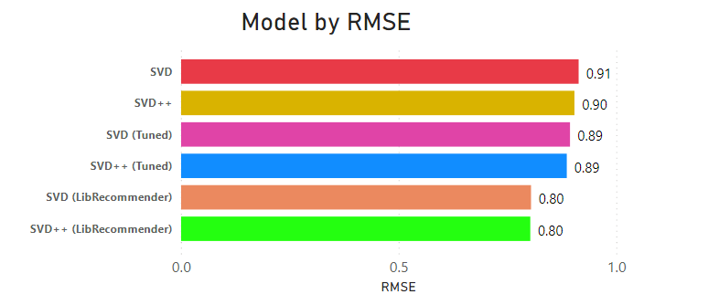
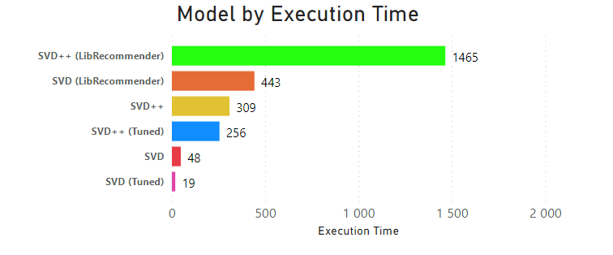
Model Evaluation

Slide 18
Conclusion
After carefully training and cross-validating a number of algorithms using features that our user’s interaction with the feature such a ratings, we observed that SVD, which uses the probability that a user is mostly to take interest in a certain product if they have interacted with that product such as rating a similar product previously, we noticed SVD did a better job at assigning probabilities of recommending an accurate movie to a certain user using users ratings

